Slide 1








CHECK IN
THIS MOVEMBER
MOVEMBER 2025 CHECK IN
Supporting Mental Health in Boys and Young Men
Proud to support
©stem4org
stem4.org.uk

Slide 2








About
  Founded in 2011 by Consultant Clinical Psychologist Dr Nihara Krause MBE
  UK youth mental health charity focused on promoting positive mental health in young people
  Our tools include 5 early intervention mental health apps to help young people stay well
  We also support families, carers, teachers, school nurses, and GPs
©stem4org
stem4.org.uk

Slide 3
Highlighting anxiety in boys and young men
1
This Year’s Movember #CheckIn
Campaign:
Encouraging students to pause, reflect, and talk about how they are feeling
2
Focusing on early support and self-care through stem4 apps
3
©stem4org
stem4.org.uk

Slide 4
Why Check In?
  Anxiety is common but often hidden
  Many boys and young men don’t ask for help because of fear, shame, or stigma
  stem4 survey of 1,100 boys aged 14–21:
37%
51%
46%
30%
reported experiencing mental health difficulties
haven’t spoken to anyone about mental health struggles
wouldn’t ask for help even if things got really bad
said they’d feel weak or ashamed; 14% said it would make them feel “less masculine”
https://stem4.org.uk/wp-content/uploads/2021/11/Toxic-masculinity-stopping-boys-seeking-mental-health-support-survey-finds-Nov-21-1.pdf
©stem4org
stem4.org.uk

Slide 5




Voices of Experience
Dr Nihara Krause says:
“We live in a culture that puts huge pressures on boys and young men to behave in particular ways, many of them damaging to their mental health. We need to listen properly, understand their needs, and create spaces where they can talk and be heard.”
Steve Reid (footballer)- panic attacks
Lewis Capaldi (singer)- anxiety
Konan (rapper)– post-traumatic stress
Harry Toffolo – mental health challenges
©stem4org

Slide 6





stem4.org.uk
How Anxiety Can Look Different
Anxiety doesn’t always look like worry. It might appear as...
  The class clown masking panic
  The chill guy who can’t sleep
  The gamer avoiding social pressure
Discussion prompt:
Can you think of examples of anxiety you’ve seen or experienced?
©stem4org

Slide 7
stem4.org.uk
C
Count your breaths:
Take a minute to focus on your breathing. Slow, deep breaths can help you notice how your body feels.
H
How’s your mood?:
Pause and ask yourself how you’re feeling emotionally- stressed, anxious, happy, or tired.
Dr Krause’s Tips
C.H.E.C.K. I.N.
E
Energy check:
Notice your energy levels. Are you drained, restless, or calm?
C
Connections:
Think about the people around you. Who can you talk to if you need support?
K
Keep a note:
Write down what’s on your mind, even a few words, it helps get your thoughts out.
©stem4org

Slide 8
stem4.org.uk
I
Identify triggers:
Spot situations or thoughts that make you anxious. Awareness is the first step to managing them.
Dr Krause’s Tips
C.H.E.C.K. I.N.
N
Next step:
Decide on one small action to support yourself, a walk, a chat with a mate, or using a coping strategy.
Discussion prompt:
What small action will you do to support yourself?
©stem4org

Slide 9

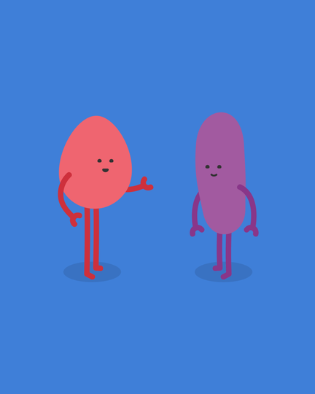

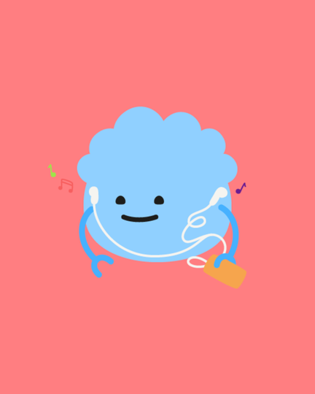
stem4.org.uk
Taking Action
  Check in with Body, Head, and Connections
  Simple strategies to support mental health:
Use the Clear Fear app to help manage symptoms of anxiety and panic
Talk to a friend, family member, or teacher. Check out stem4’s ‘Asking for Help’ resource for tips and advice.
Try a breathing or grounding exercise, such as ones on the Clear Fear app, to help calm your body and manage the physical feelings that come with anxiety.
Take a few minutes each day to pause, breathe, and refocus, small breaks can make a big difference in how you feel.
©stem4org

Slide 10
CHECK IN
THIS MOVEMBER
Check in with yourself, a mate, or a trusted adult.
Visit stem4.org.uk
Proud to support
©stem4org
stem4.org.uk

