Slide 1


Assembly Presentation
Notes:
FROM stem4: Remember to only read the black writing and not the blue writing. Take a deep breath and enjoy yourself. Thank you for supporting positive mental health in teenagers.
STUDENT SCRIPT – SLIDE 1
Welcome to our assembly on the charity stem4 – a charity that promotes positive mental health in teenagers and those who support them.
We attended a stem4 student conference and are excited to share stem4’s mission with you today.

Slide 2

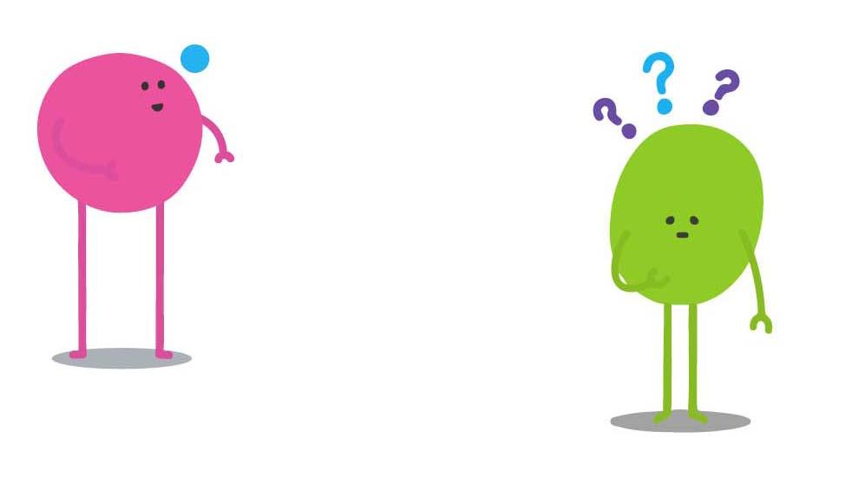

stem4 was founded in 2011
by Consultant Clinical Psychologist
Dr Nihara Krause
Notes:
STUDENT SCRIPT – SLIDE 2 - The stem4 story
Nearly 11 years ago, a clinical psychologist called Dr Nihara Krause sat in her kitchen and worried. She worried about all the young people out there who, that very evening, were feeling sad, stressed, anxious and alone, and who didn’t know how to ask for help or who to turn to.
She knew that talking about mental health was often really difficult, that many people hadn’t heard about a lot of mental health conditions, and that the waiting lists to get professional help were really long. She knew that something needed to be done and so she started stem4.

Slide 3
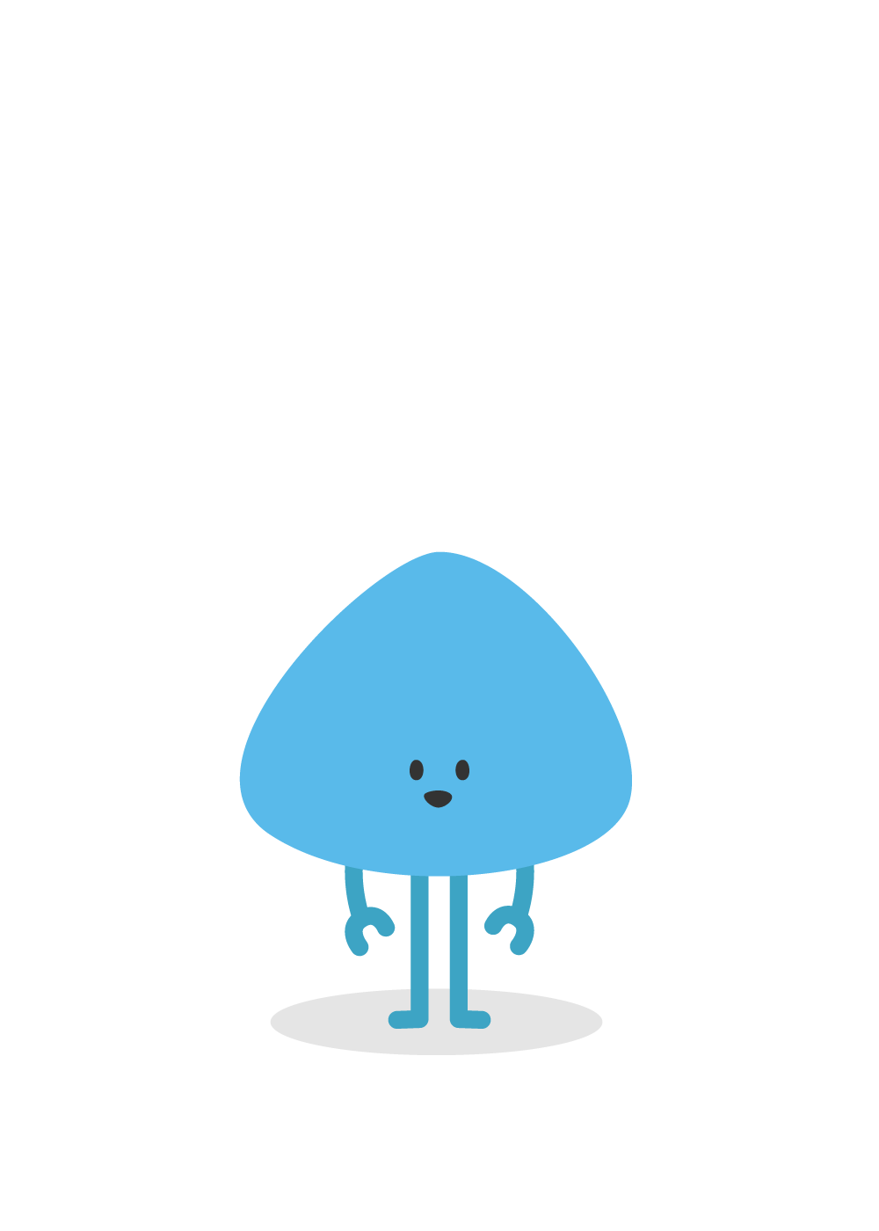

1 in 6 young people have experienced mental ill health
Notes:
STUDENT SCRIPT – SLIDE 3
A survey completed by the NHS in 2017, showed that 1 in 9 young people had experienced a mental health disorder and another survey completed in 2021 showed that the number had increased to 1 in 6 young people between the ages of 5 and 16 years.
The pandemic has had an enormous impact on mental health with marked increases in eating and sleeping problems in young people.
DON’T READ ALOUD:
Evidence for the statistics above can be found here:
https://digital.nhs.uk/data-and-information/publications/statistical/mental-health-of-children-and-young-people-in-england/2021-follow-up-to-the-2017-survey

Slide 4
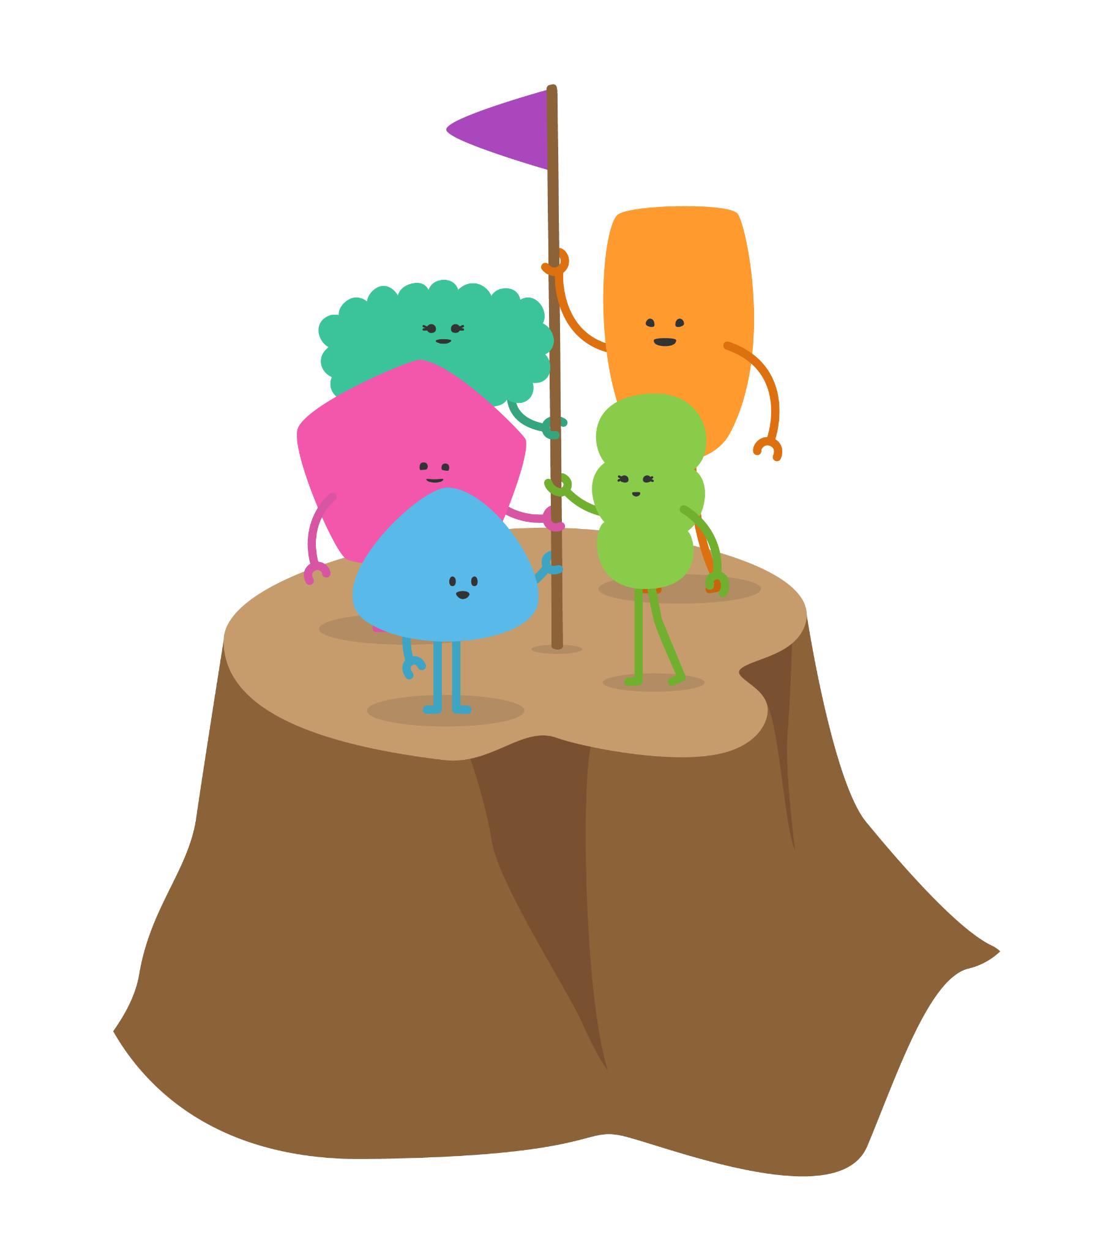
stem4’s Mission
To educate on the early signs and symptoms of mental ill-health, so that we can enhance early detection
and prevent mental
illness.
Notes:
STUDENT SCRIPT – SLIDE 4
And so stem4 continues its mission to educate young people, their parents, teachers and health professionals on the early signs and symptoms of mental ill-health, so that there is early detection of mental ill health and prevention mental illness.

Slide 5
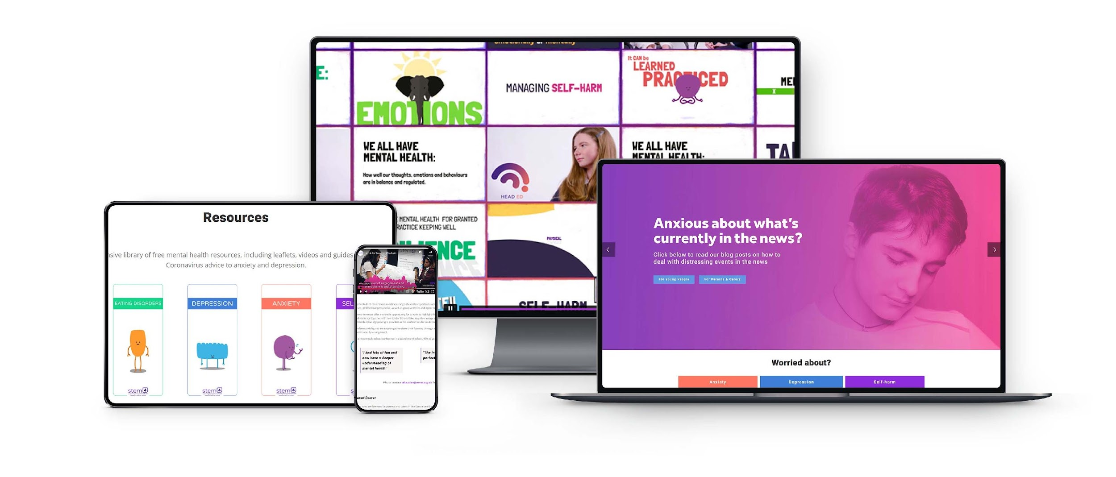
You might know stem4 through their website
and free resources, conferences, or Head Ed
(stem4’s mental health literacy resource)
stem4.org.uk
Notes:
STUDENT SCRIPT – SLIDE 5
You might know stem4 through their website and free resources – or you might have heard about them in Tom Holland’s recent insta post but in order to create awareness of different mental health topics, they created a website, started running conferences, shared loads of information booklets and also created ‘Head Ed’ to help teachers share topics like anxiety, depression, stress, self-harm and eating disorders.

Slide 6
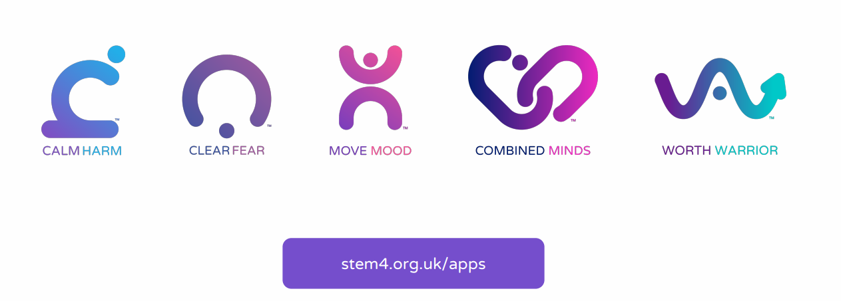
stem4’s free apps
Notes:
STUDENT SCRIPT – SLIDE 6
Even with a website and conferences, Dr Krause wanted to reach and help many, many more young people from all over the country, so she decided to create apps that could be downloaded for free by any young person who might need them. She designed them using her clinical expertise with input from young people like ourselves and also made sure that they met strict NHS criteria for safety and effectiveness.
stem4’s first app is called Calm Harm. It helps young people manage or resist the urge to self-harm and has been downloaded over 2 million times worldwide.
Their second app is called Clear Fear. Clear Fear is a free app to help young people manage the symptoms of anxiety. It’s got lots of tips and useful exercises and with exam season round the corner, could prove very useful.
Move Mood is a free app to help young people manage the behaviours associated with low mood or depression. It’s also great to help motivate yourself through setting goals and targets.
And Combined Minds is a free app to help families and friends provide mental health support and at a time when services are stretched can prove very useful.
stem4’s newest app is called Worth Warrior and this app helps to build self-esteem and manage low self worth and poor body image.

Slide 7

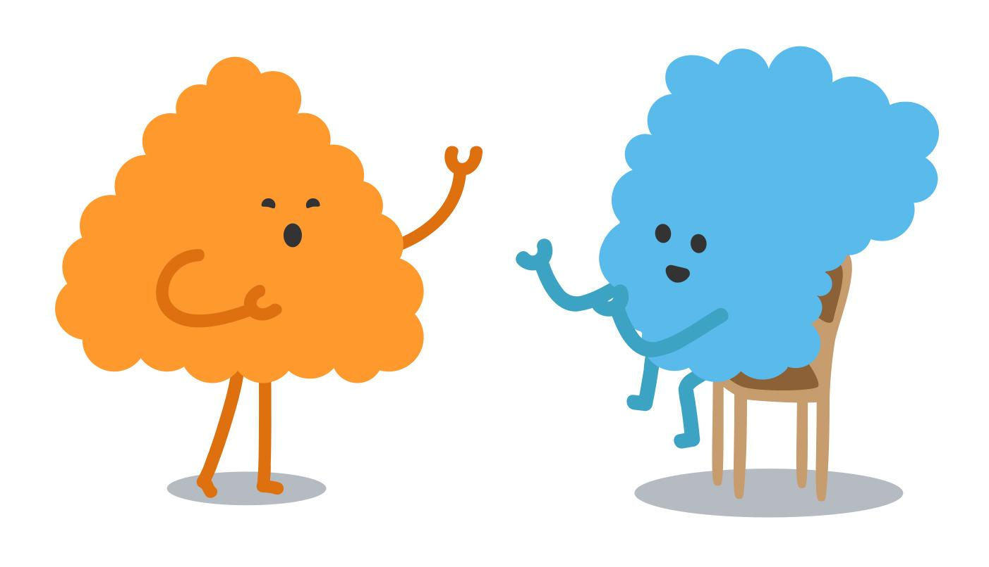
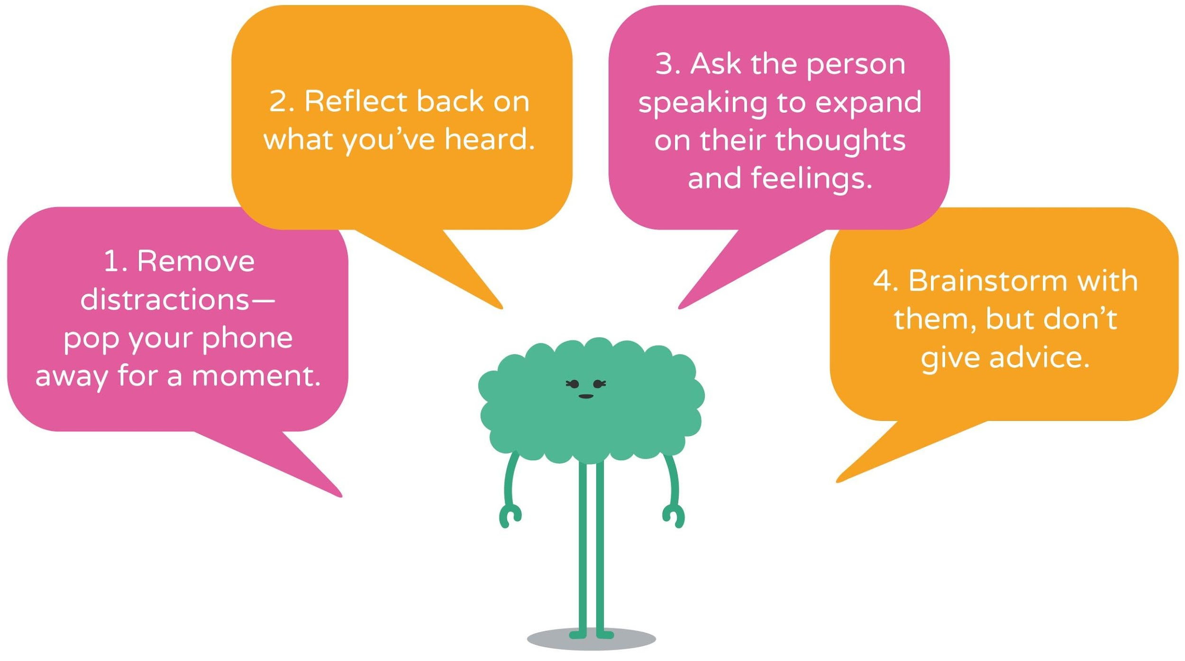

Notes:
STUDENT SCRIPT – SLIDE 8
stem4 loves to support young people, their families, friends and teachers but they need our help to create awareness in our community.
They need us all to be ambassadors for positive mental health and so they have shared some tips on how we can do this with our friends – the system is called ‘Friends Watch’ and it consists of 4 steps.

Slide 8


1.Talk
Make you feel
seen and heard
I’m a little worried, you don’t seem yourself
Heh? Hmmm
.
Notes:
STUDENT SCRIPT – SLIDE 9
Tip 1: Find the right time and place to talk to your friend; listen but don’t criticise.
Don’t directly mention the details of what you are concerned about but do say that you are concerned. Don’t offer confidentiality, you may need to tell a trusted adult that you are concerned about your friend and don’t be surprised if they are not willing to talk or listen. It may take time and gentle repetition.
You could say,
‘I am a little worried; I’ve noticed that you don’t seem yourself; Is there anything you would like to share with me?’ or if you ask if they are ok and they say ‘yes I’m fine’ then ask again ‘are you really ok?’
Often when people are given the opportunity to move past the first greeting, when it’s hard to start with being ‘heavy’, they are more comfortable with starting a proper conversation.

Slide 9

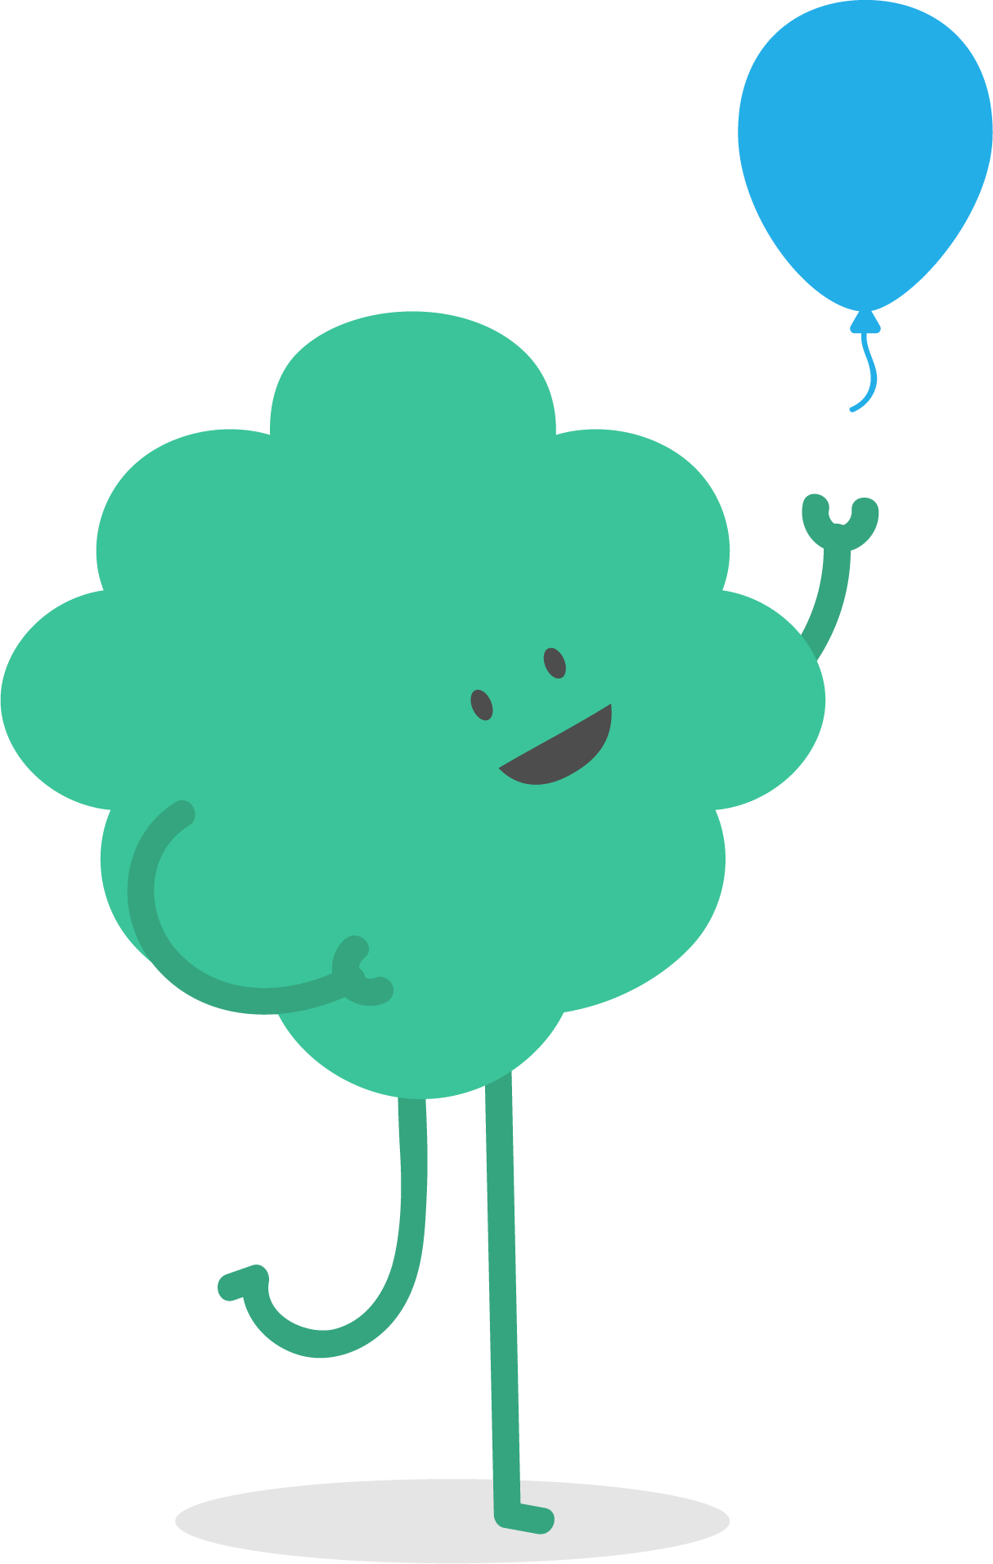
2. Offer
I’ll go with you
I could talk to Mr H
Think for a moment bouhmakes
a connection meaning .
Notes:
STUDENT SCRIPT - SLIDE 11
Tip 3: Offer to support them by finding useful information. Offer to accompany them to see a trusted adult that may be able to help.
You could say, ‘Would you like me to come with you to see (a teacher you know they can talk to)? Have you seen these useful helplines on the stem4 webpage?’

Slide 10
3. Tell
Tell me about it
I need some
help
Notes:
STUDENT SCRIPT – SLIDE 10
Tip 2: Tell your friend that you are worried about them and encourage them to tell a responsible adult who can help access further support. You might need to suggest who that person could be, such as their parent/carer, a teacher, a school counsellor or peer counsellor, school nurse.
You could say, ‘Is there an adult you would like to talk to? Could you talk to your mum/dad/sibling/peer counsellor/teacher?’

Slide 11
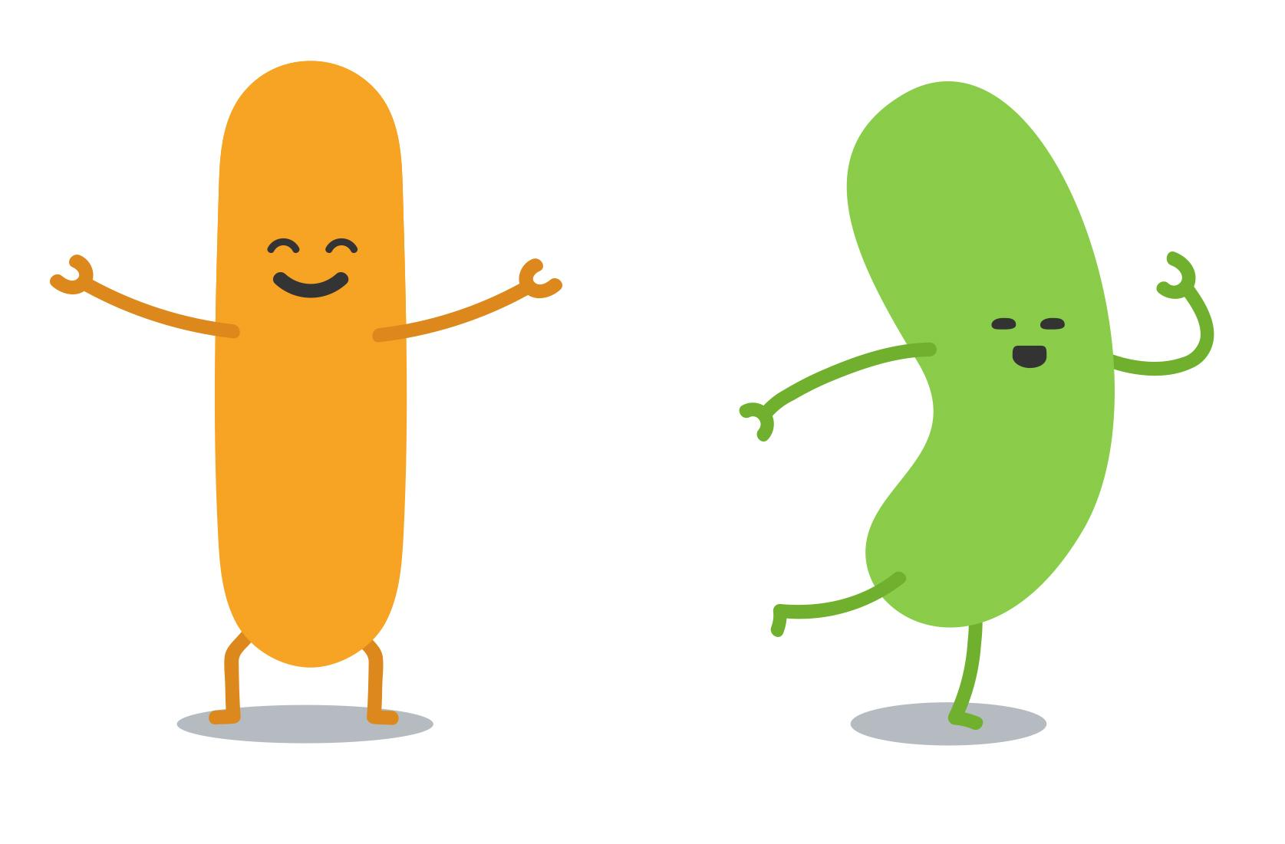
4. Look after yourself too
Let’s play some Xbox
That will be awesome
Think for a moment bout what makes
a connection meaningful o you.
Notes:
STUDENT SCRIPT – SLIDE 12
And lastly Tip 4: Look after yourself
Don’t feel guilty and avoid being over-responsible. Supporting a friend is difficult and it affects our own emotional well-being. Only help where you can, it’s not your responsibility to ‘treat’ your friend, but it is your responsibility to be supportive. Make sure you take breaks when helping others, so that you can have some time to focus on yourself and relax. Take steps to talk to someone too if you feel it is getting you down.

Slide 12
What can we do here at our school?
1.
2
3
4
Notes:
STUDENT SCRIPT – SLIDE 13
So what can we do here at our school to help each other, promote awareness of mental health and support positive mental health?
(Check with your teacher before you present to make sure these ideas are ok to put into practise)
1.
2.
3.
4.

Slide 13

Where to get help
National signposts
Local signposts
Think of your own, starting with family, friends, and school. Who else could you connect with locally? Keep this information to hand!
Notes:
STUDENT SCRIPT – SLIDE 14
If you are listening to this today and are struggling with your feelings, please reach out to someone. You can have a look at the stem4 website at stem4.org.uk and their booklet on how to ask for help, and there are lots of charities that you can text to receive support like Shout, Kooth and Togetherall.
At our school you can talk to: (List counsellors, teachers, friends, mental health ambassadors or anyone who you think is responsible and available in your school community)

Slide 14

Notes:
STUDENT SCRIPT – SLIDE 15
You are now all stem4 ambassadors – go out there, look after each other and join stem4’s mission to support positive mental health.

